Slide 1


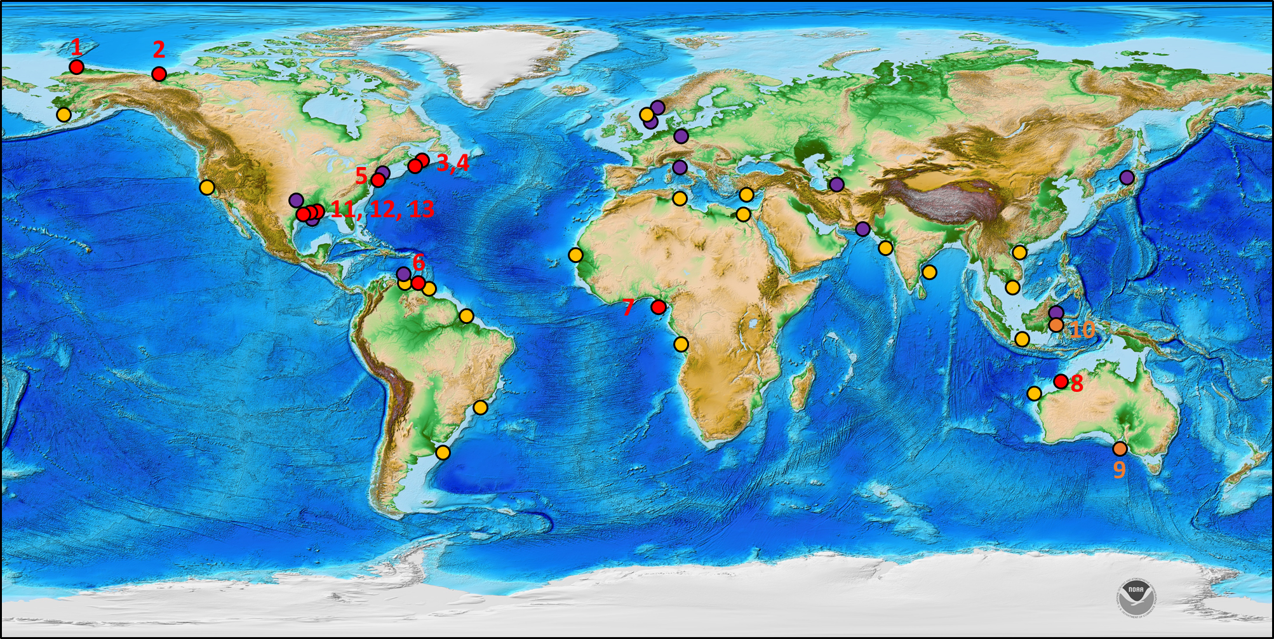
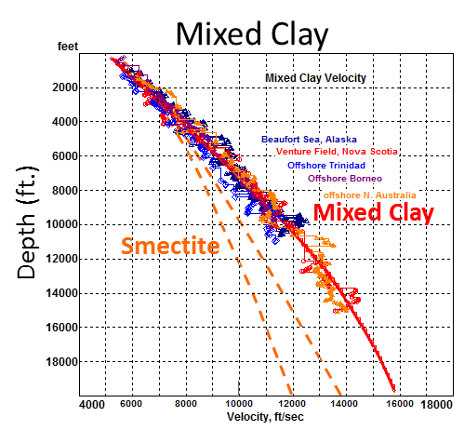
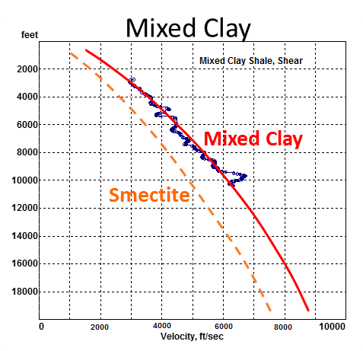
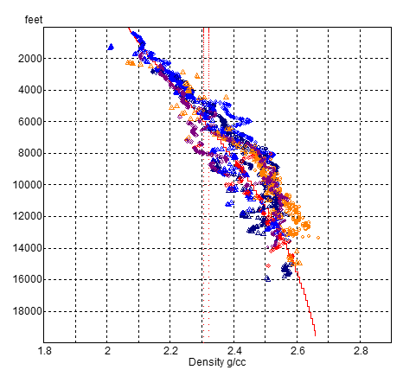
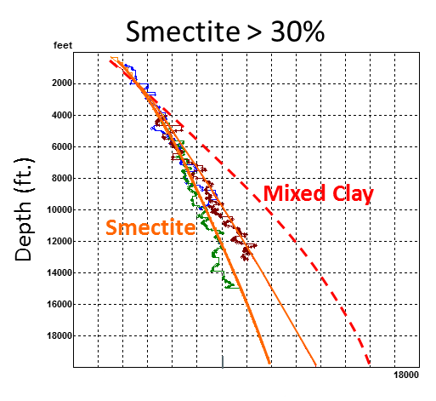
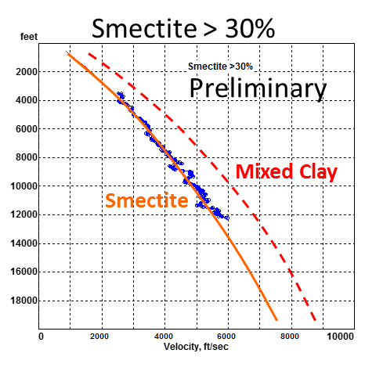
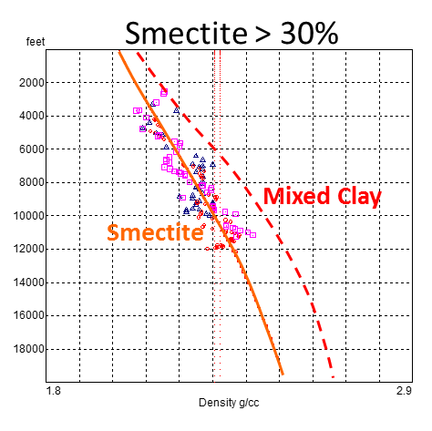
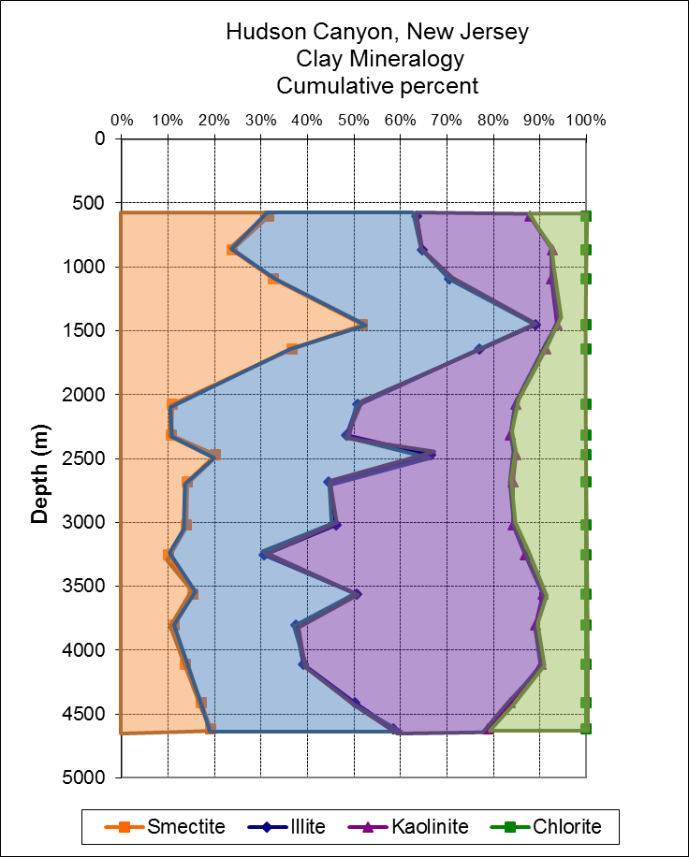
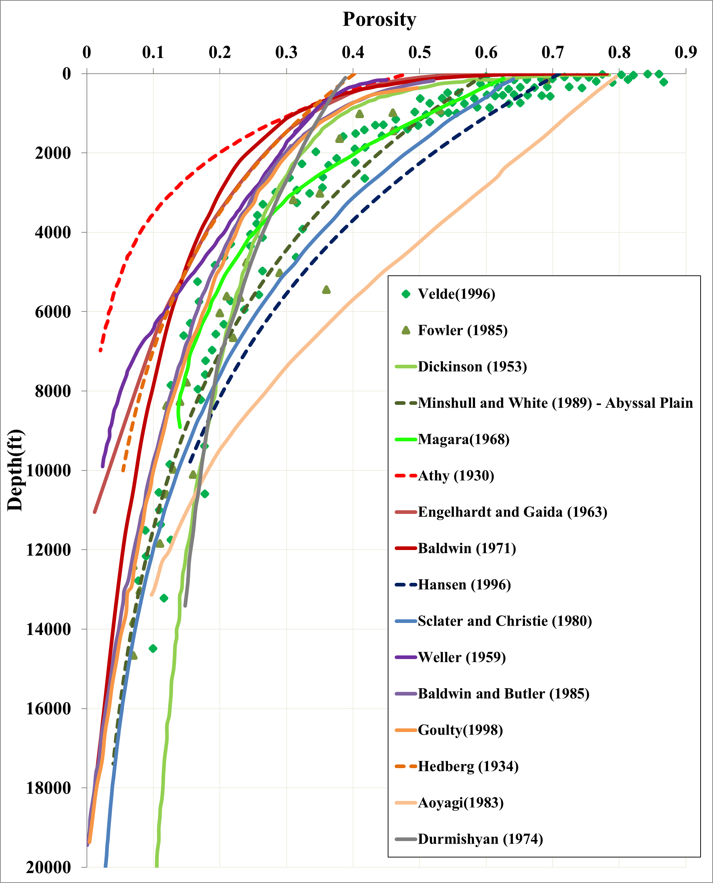
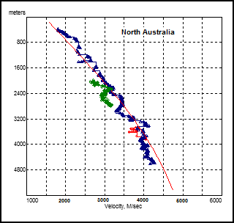
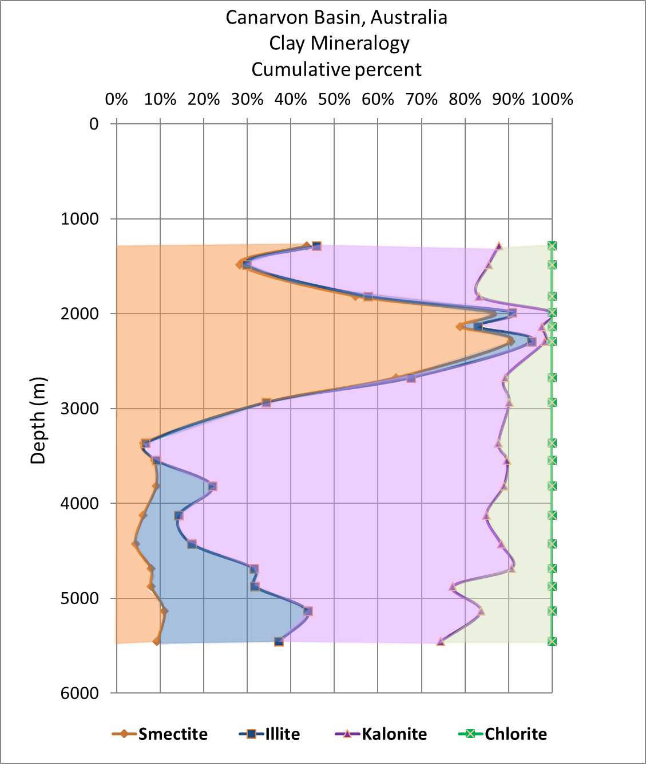
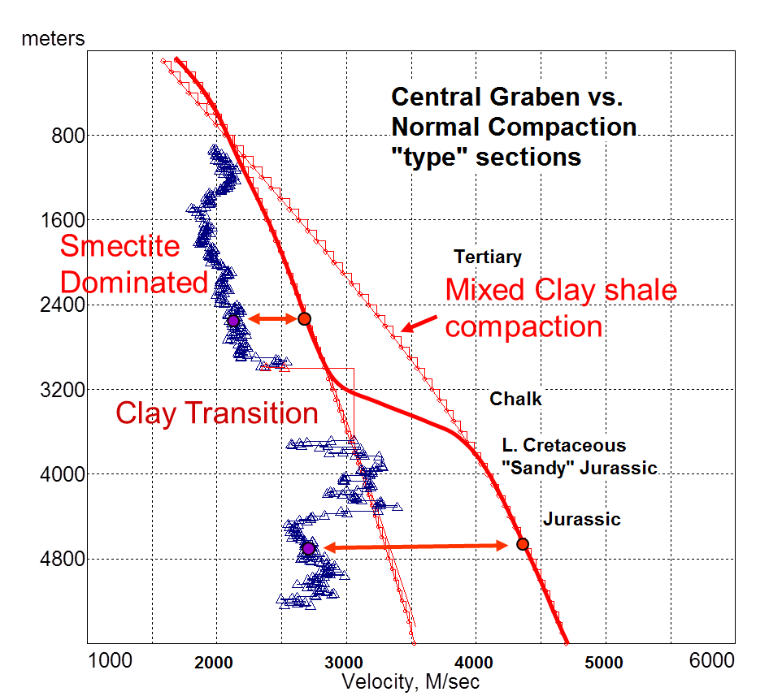
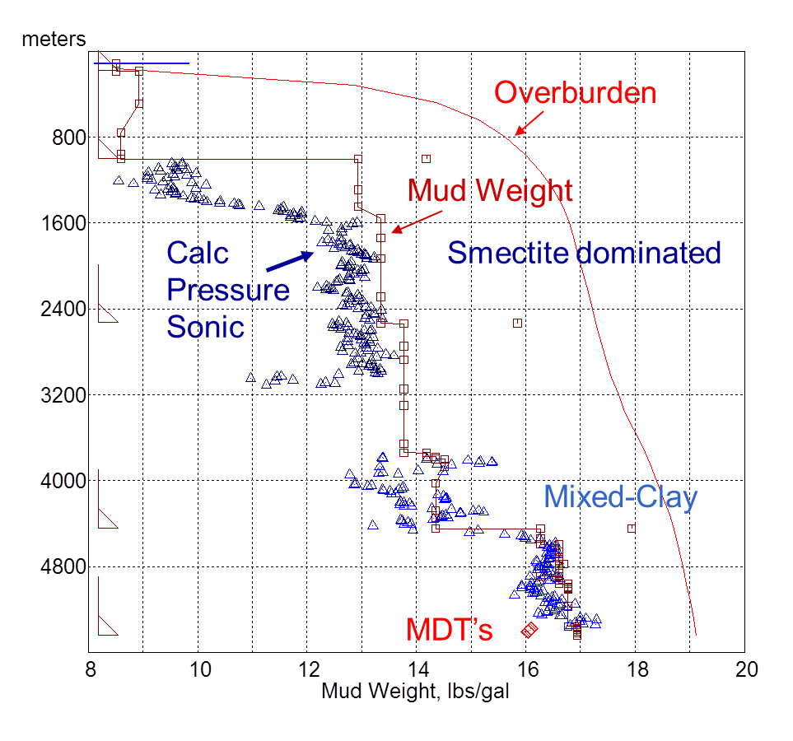
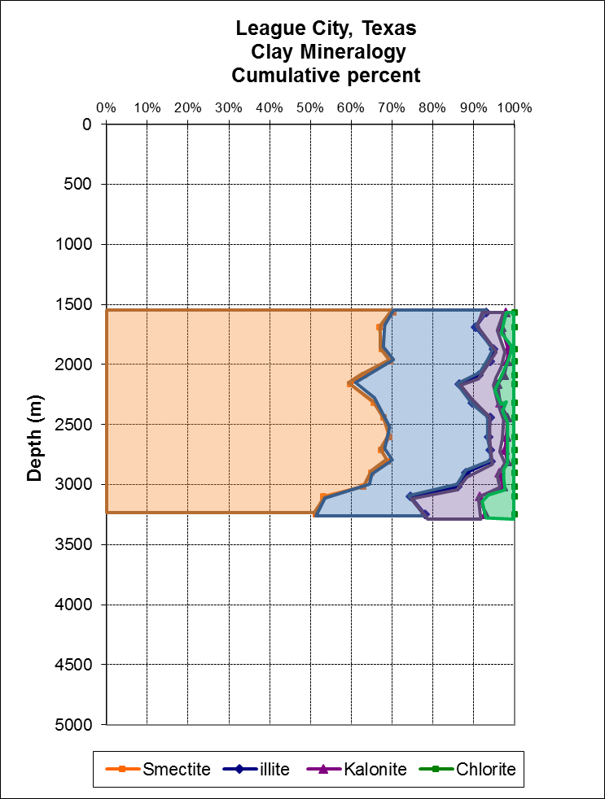
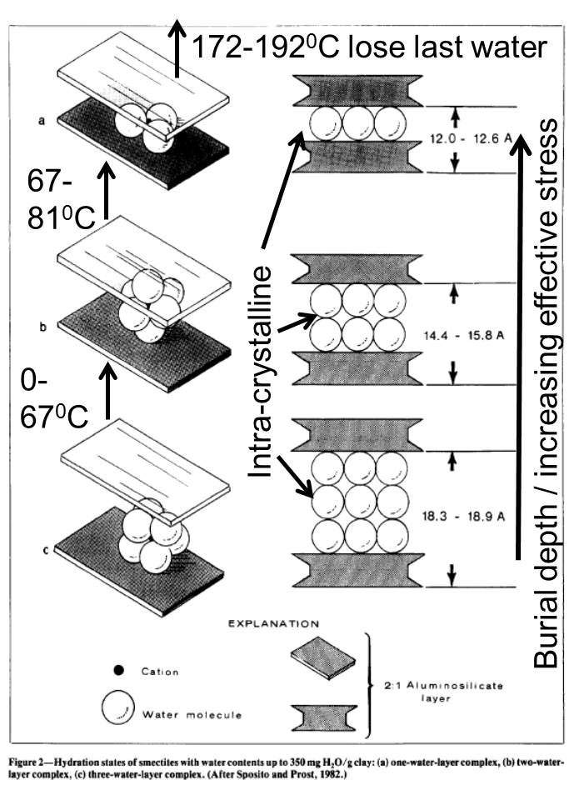
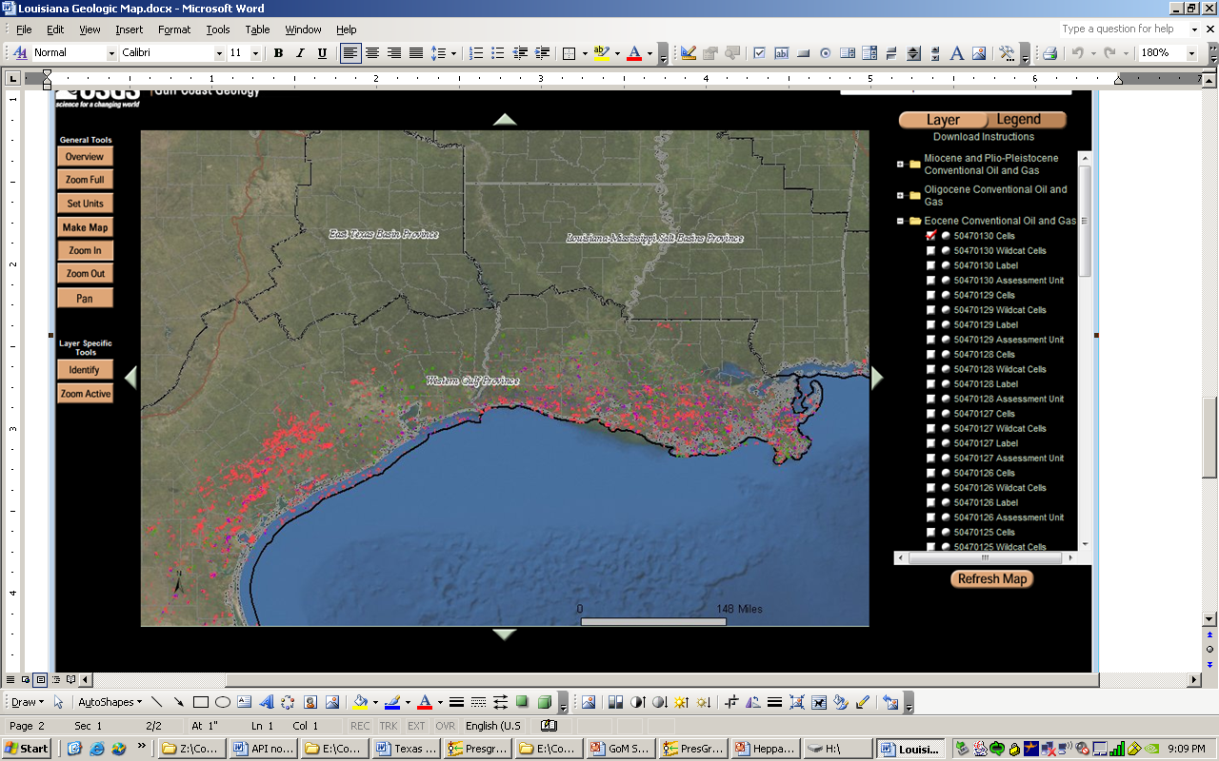
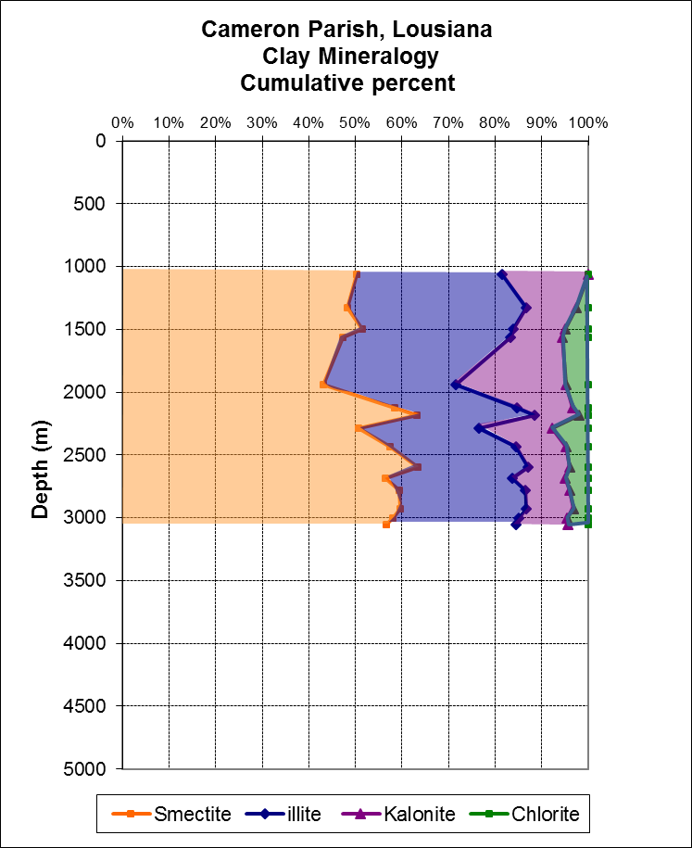
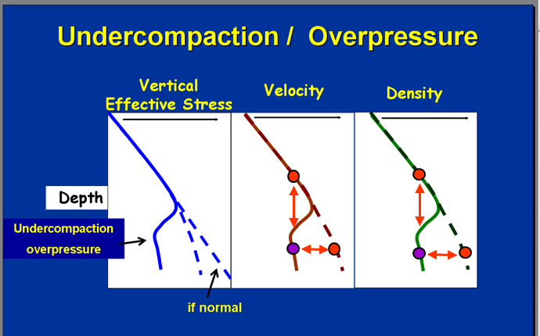
A Global View of Clay Rock Normal Compaction
Harsha Vora¹ ,Philip Heppard²
¹Department of Earth Science, Rice University (hv6@rice.edu)
²Applied Geosciences, ConocoPhillips Company
Abstract
Global Compaction Trends and Clay Mineralogy
Smectite-rich and Mixed clay compaction trends
Porosity reduction during the burial of clay rocks, compaction, has been a subject of interest for many years (Athy, 1930, Mondol et. al., 2007). Contemporary research interest in this subject commonly includes the comparison of a number of normal compaction trends derived from basins as well as the results from compaction studies conducted in a laboratory. These comparisons show a wide range of compaction trends with the commonality being increasing compaction with depth, but at any depth a very wide scatter in trends is observed and making predictions becomes hard. Consequently, various studies have tried to understand the scatter in compaction trends by attributing the behavior to a number of geologic factors.
We propose that in most clastic dominated basins that clay rock compaction is actually fairly well constrained and predictable. A brief review of the published compaction trends suggests that outliers are from basins that have undergone a complicated geologic history and are now out of place and not at maximum burial depth. Our work supports recent evaluations of clay rock compaction which indicates that the composition of the clay rock does significantly affect the rate of compaction. Lahann, (2002, 2004), Katahara (2003), and Alberty and McLean (2003) support a similar conclusion that smectite-rich clay rocks will compact at a much slower rate than illite or mixed-clay rich clay rocks or shale.
1,2. Beaufort – MacKenzie, Alaska
P – wave velocity
S – wave velocity
Density (g/cc)
The largest control on petrophysical trends such as velocity, density and porosity of shales is the amount of smectite grains.
At smectite abundance > 30 %, we see a significant deviation from the mixed clay compaction curve
3,4. Nova Scotia
Current clay mineralogy and normal compaction study
Ongoing Analysis
Implications for Pore Pressure Prediction
Past experience of significant normal pressure section
Contemporary literature
Pressure Interpretation from Gulf of Mexico Onshore
5. New Jersey
6. Trinidad
7. Nigeria
Normal Compaction trends
Smectite dominated curve accurately predicts pore pressure in shallow sections Gulf of Mexico and Central Graben, North Sea.
After smectite-illite transition depth (~10000 ft.) , mixed clay curve is used for accurate pore pressure prediction
Smectite
Mixed Clay
Drilling Mud Weight
From basins currently at maximum burial depth
Fowler (1985)
Minshul and White (1989)
Velde (1996)
Magara (1968)
Dickinson (1953)
Transition
Calculated
Pressure
8. Canarvon Basin, Australia
9. Otway Basin
10. Borneo
11,12, 13. Gulf of Mexico
Pressure Interpretation from Central Graben, North Sea
Compaction trends from Gulf of Mexico are significantly slower due to clay mineralogy
Marl
Others:
Uplifted & deeply eroded
Over-pressured clay rocks
Curves re-worked from previous literature
Laboratory compaction experiments, unknown sources
Compaction trends from Gulf of Mexico, smectite dominated mudstones and shales, have lower P and S wave velocities and porosity
11. League City, Texas
Results
Clay rocks compact in a largely predictable manner with increasing effective stress
Global examples indicate compaction is very similar for “mixed-clay” rocks
Smectite content over 30% can significantly affect compaction
Upon increasing effective stress, smectite and illite grains follow different paths of porosity reduction.
Smectites are expandable and much more porous than illite grains due to presence of interlayer or intra-crystalline water, in addition to clay-bound water.
12. Cameron Parish Louisiana
Using Bowers (1994)
Velocity = 5000 + Aσ^{B}
Smectite-Rich
A = 14.0; B = 0.67 (to 0.68)
Mixed-Clay (rest of world)
A = 14.0; B = 0.72
Most pressure to predict pressure equations relate an observed value compared to a “normal compaction” value
13. Terrebone Parish, Louisiana
REFERENCES
Mondol, Nazmul H., et al. "Experimental mechanical compaction of clay mineral aggregates—Changes in physical properties of mudstones during burial.“, 2007.
Lahann, Richard. "Impact of smectite diagenesis on compaction modeling and compaction equilibrium.“, 2002.
Katahara, Keith. "Overpressure and shale properties: Stress unloading or smectite-illite transformation?.", 2006.
Bowers, Glenn L. "Pore pressure estimation from velocity data: Accounting for overpressure mechanisms besides undercompaction.“, 1995.
Colton-Bradley, V. A. C. "Role of pressure in smectite dehydration—Effects on geopressure and smectite-to-illite transition.“, 1987.
Alberty, Mark W., and Michael R. McLean. "Emerging trends in pressure prediction.", 2003.

